Slide 1

Pedestrian Traffic Analysis
By Henry Kaplan and Derek Plemons

Slide 2
Table of Contents
Research
Data
Analysis
Mapillary Traffic Signs
Mapillary Traffic Points
Pedestrian Traffic Collisions (2010-2020)
Summary
Recommendations

Slide 3
Purpose
Use an API to retrieve information from Mapillary describing the location of high density crossings and flashing walk signs to guide the zoning of new pedestrian safe zones by city officials. The interface for the API has already been written for a previous Hack For LA project.
Reduce Accidents
Identify high traffic/ accident intersections
Incentivize more walking

Slide 4
Data
LA Neighborhood Council Shape File: https://data.lacity.org/City-Infrastructure-Service-Requests/Neighborhood-Councils-Certified-/fu65-dz2f
2. Mapillary API: (Documentation) https://www.mapillary.com/developer/api-documentation/#traffic-signs
Traffic Accidents by Date: https://data.lacity.org/Public-Safety/Traffic-Accidents-by-date/2mzm-av8t
Mapping LA's Most Dangerous Intersections: https://la.curbed.com/2013/9/20/10195638/mapping-los-angeless-53-most-dangerous-intersections
2019 Walk Bike Count: https://data.lacity.org/dataset/2019-Walk-Bike-Count-Data/m6qi-ifup

Slide 5
Analysis
Google Colab Notebook: https://colab.research.google.com/drive/1R_RN06z1m543mekGn3fGvs6Z6gmhgay6?usp=sharing

Slide 6
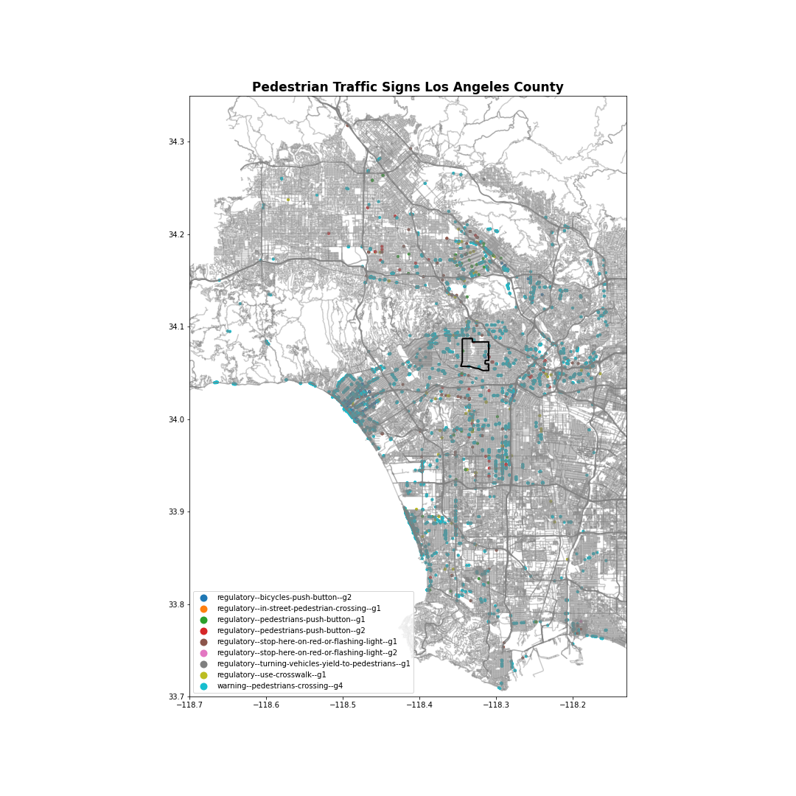
Mapillary Traffic Signs
4543 - warning--pedestrians-crossing--g4
119 - regulatory--bicycles-push-button--g2
108 - regulatory--stop-here-on-red-or-flashing-light--g1
105 - regulatory-use-crosswalk--g1
61 - regulatory--pedestrians-push-button--g1
49 - regulatory-pedestrians-push-button--g2
11 - regulatory--turning-vehicles-yield-to-pedestrians--g1
1 - regulatory--stop-her-on-red-or-flashing-light--g2
1 - regulatory--in-street-pedestrian-crossing--g1

Slide 7
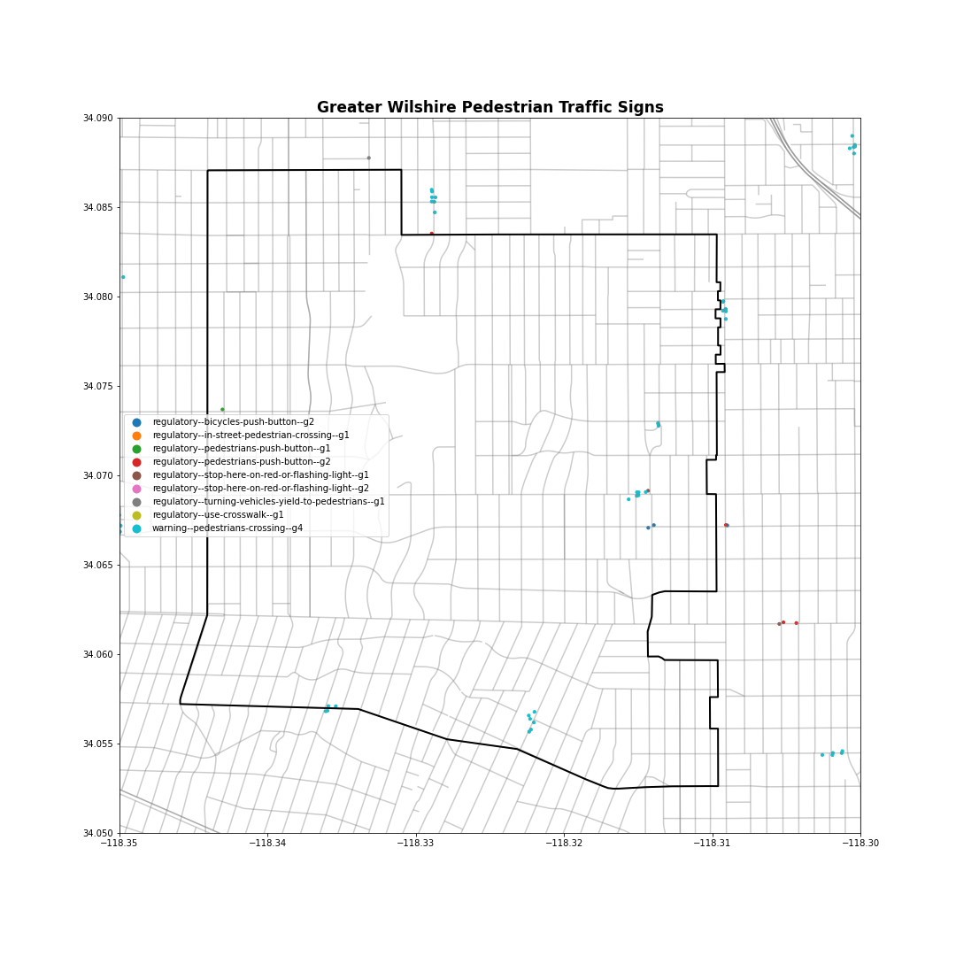
Mapillary Traffic Signs
To do: Need to identify which traffic signs are located in Greater Wilshire.

Slide 8
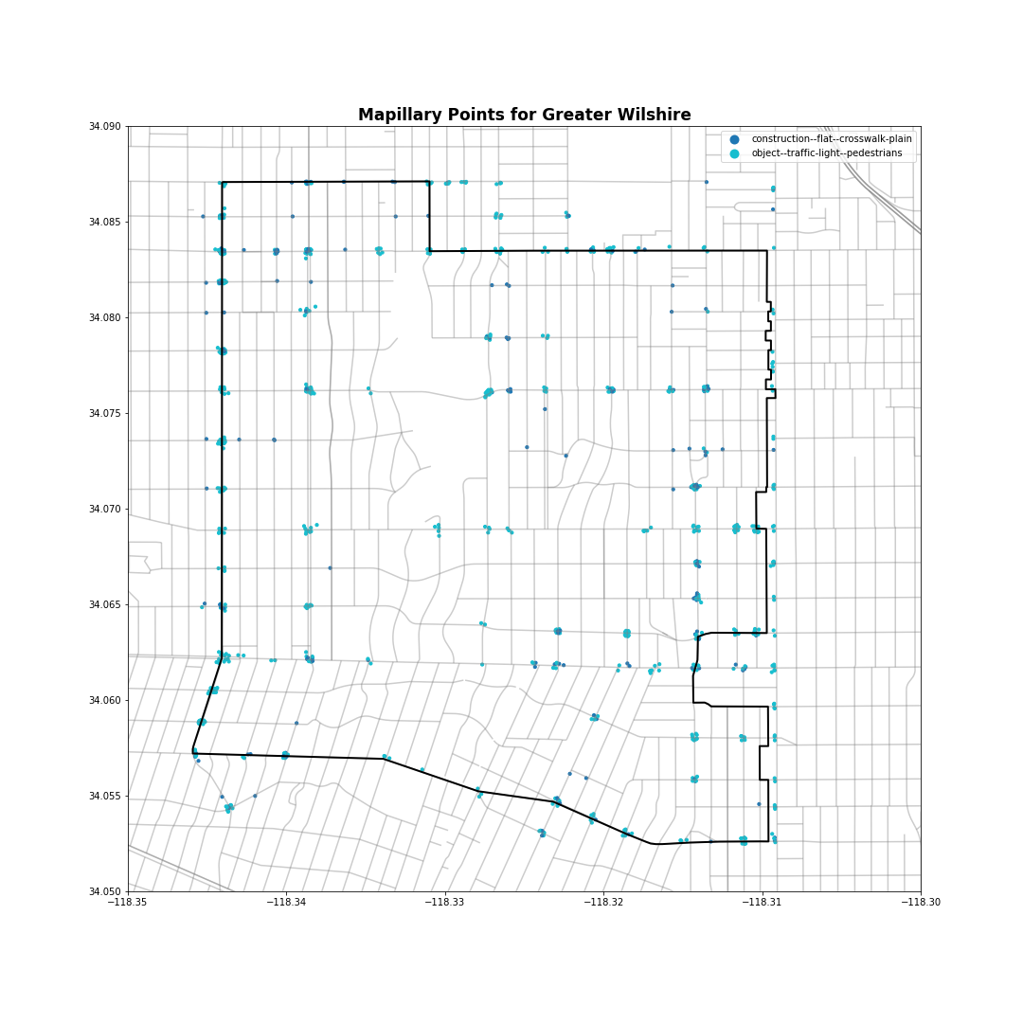
Mapillary Traffic Points
object--traffic-light--pedestrians 583
construction--flat--crosswalk-plain 215

Slide 9
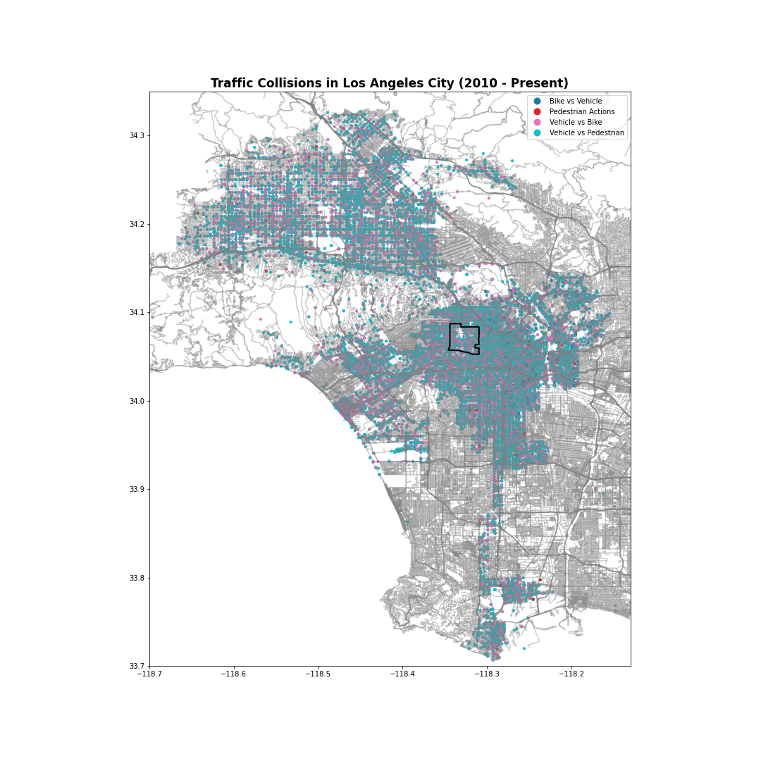
Los Angeles Pedestrian Traffic Collisions (2010-2020)
Count of Traffic Collisions:
30319 - Vehicle vs Pedestrian
17683 - Vehicle vs Bike
1401 - Bike vs Vehicle
553 - Pedestrian Actions

Slide 10
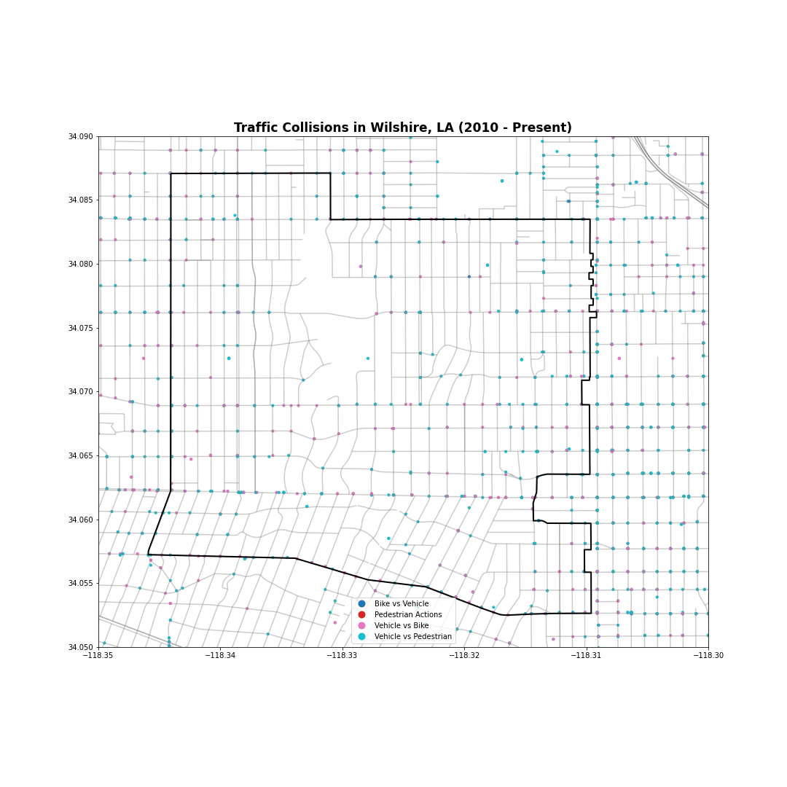
Los Angeles Pedestrian Traffic Collisions (2010-2020)

Slide 11
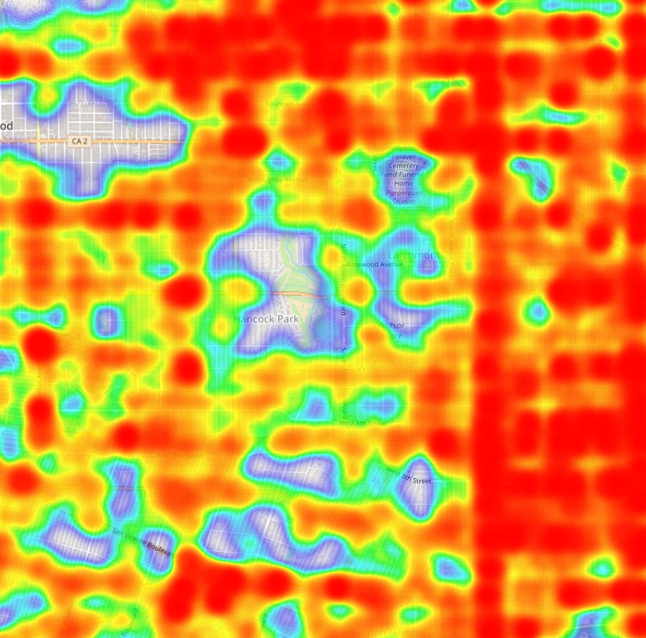
Los Angeles Pedestrian Traffic Collisions (2010-2020) Heatmap

Slide 12
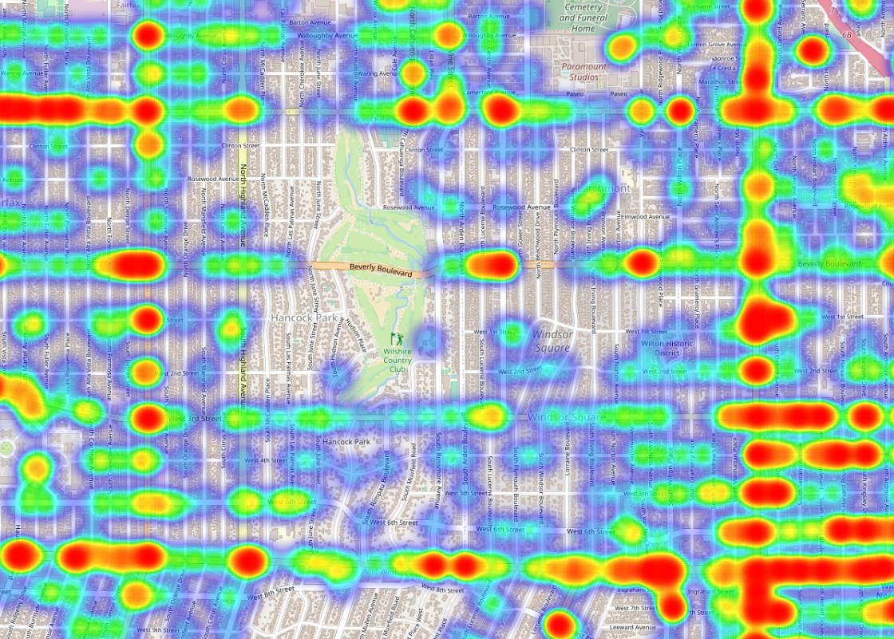
Los Angeles Pedestrian Traffic Collisions (2010-2020) Heatmap

Slide 13
Summary

Slide 14
Recommendation

